Slide 1
Inquisitive semantics beyond questions
Daria Popova
HSE University
Spring School of Logic, Linguistics and Formal Philosophy
23-28.03.2026

Slide 2
Inquisitive semantics: Introduction
Inquisitive semantics is a semantic framework for the analysis of linguistic information exchange.
Information exchange is seen as a process of raising and resolving issues.
Inquisitive semantics provides a new formal notion of issues, which makes it possible to model the semantic content of both declarative and interrogative sentences in an integrated way, capturing not only the information that such sentences convey but also the issues that they raise, which makes it possible to model various concepts that are crucial for the analysis of linguistic information exchange in a more refined and more principled way than has been possible in previous frameworks.
Ciardelli et al. 2017

Slide 3
Inquisitive semantics: Motivation
Why do we need a formal notion of issues?
Reason 1: To represent the content of interrogative sentences
The semantic content of a declarative sentence is standardly construed as a set of possible worlds, those worlds that are compatible with the information that the sentence conveys.
This set of worlds is referred to as the proposition that the sentence expresses. This notion of semantic content works well for declarative sentences, whose main conversational role is indeed to provide information.
Can the semantic content of an interrogative sentence be construed as a set of possible worlds as well?
Ivan is calling.
Is Ivan calling?
“An interrogative sentence and an indicative one contain the same thought; but the indicative contains something else as well, namely, the assertion. The interrogative sentence contains something more too, namely a request. Therefore two things must be distinguished in an indicative sentence: the content, which it has in common with the corresponding sentence-question, and the assertion.” (Frege, 1918)
So the idea is that declaratives and interrogatives have the same semantic content—a proposition—but come with a different force—either assertion or request.
Ciardelli et al. 2017

Slide 4
Inquisitive semantics: Motivation
Why do we need a formal notion of issues?
Reason 1: To represent the content of interrogative sentences
Is Ivan calling, or Penny?
Who is calling?
John knows that Ivan is calling.
John knows whether Ivan is calling.
If the embedded clauses had the same content, then by the principle of compositionality the two sentences as a whole should also have the same content. But this is clearly not the case. So the embedded clauses must differ in content.
Thus, the standard notion of semantic content does not seem applicable to interrogative sentences. Rather, what we need for interrogatives is a notion of content that directly captures the issues that they raise.
Ciardelli et al. 2017

Slide 5
Inquisitive semantics: Motivation
Why do we need a formal notion of issues?
Reason 2: To model conversational contexts
Conversational contexts are modeled in a way that does not only take account of the information that has been established in the conversation so far, but also of the issues that have been brought up, often referred to as the questions under discussion.
(1) A: What did you do this morning?
B: I read the newspaper. Implicature: B did not do the laundry
(2) A: What did you read this morning?
B: I read the newspaper. Implicature: B did not read anything besides the newspaper
Ciardelli et al. 2017

Slide 6
Inquisitive semantics: Motivation
Why do we need a formal notion of issues?
Reason 2: To model conversational contexts
Conversational contexts are modeled in a way that does not only take account of the information that has been established in the conversation so far, but also of the issues that have been brought up, often referred to as the questions under discussion.
(1) A: Who did Alf rescue?
B: Alf rescued ZOE [FOC]. / #ALF [FOC] rescued Zoe.
(2) A: Who rescued Zoe?
B: ALF [FOC] rescued Zoe. / #Alf rescued ZOE [FOC].
Focus marking, just like pragmatic reasoning, is sensitive to the issue under discussion.
Ciardelli et al. 2017

Slide 7
Inquisitive semantics: Motivation
Why do we need a formal notion of issues?
Reason 3: To model issue-directed propositional attitudes and capture the meaning of verbs that report such attitudes
Just like there are verbs like know and believe that describe the information state of an agent, as in (1) below, there are also verbs like wonder and be curious that describe the inquisitive state of an agent, as in (2).
(1) John knows that Bill is coming.
(2) John wonders who is coming.
Knowledge and belief are information-directed propositional attitudes; wondering is an issue-directed propositional attitude. The standard way to model the knowledge and beliefs of an agent is as a set of possible worlds, namely those worlds that are compatible with what the agent knows or believes. Such a set of worlds is thought of as representing the agent’s information state. Similarly, in order to capture what an agent wonders about, we need a representation of her inquisitive state. For such a representation, we again need a formal notion of issues.
Ciardelli et al. 2017

Slide 8
Inquisitive semantics: Motivation
Declaratives and interrogatives can’t be treated separately
Reason 1: Mutual embedding
Declarative and interrogative sentences can be embedded into one another:
(1) Bill asked me who won. embedded interrogative
(2) Who told you that Jane won? embedded declarative
(3) Bill asked me who told you that Jane won. two-level embedding
So the meaning of a declarative sentence is sometimes partly determined by the meaning of an embedded interrogative sentence, and vice versa.
Ciardelli et al. 2017

Slide 9
Inquisitive semantics: Motivation
Declaratives and interrogatives can’t be treated separately
Reason 2: Interpretational dependencies
The interpretation of a declarative sentence depends on the issue raised by a preceding interrogative:
(1) A: What did you do this morning?
B: I only read the newspaper. Implicature: B did not do the laundry
(2) A: What did you read this morning?
B: I only read the newspaper. Impl.: B did not read anything besides the newspaper
Ciardelli et al. 2017

Slide 10
Inquisitive semantics: Motivation
Why do we need an integrated notion of semantic content?
Reason 1: Common building blocks
Declaratives and interrogatives are to a large extent built up from the same lexical, morphological, and intonational elements.
(1) Luca is from Italy↑ or from Spain↓.
(2) Is Luca from Italy↑ or from Spain↓?
In declaratives, or is normally taken to yield the union of the semantic values of the disjuncts. In (1), each disjunct expresses a proposition, standardly represented as a set of possible worlds: the semantic value of the first disjunct is the set of worlds where Luca is from Italy, and the semantic value of the second disjunct is the set of worlds where Luca is from Spain. The proposition expressed by (1) is the union of these two sets. This seems a reasonable account of or in declaratives. But what is the role of or in interrogatives?
Ciardelli et al. 2017

Slide 11
Inquisitive semantics: Motivation
Why do we need an integrated notion of semantic content?
Reason 2: Entailment
We need a notion of entailment which is sensitive to both informative and inquisitive strength
(1) a. The number of planets is 8. Entails:
b. The number of planets is even.
(2) a. What is the number of planets? Entails:
b. Is the number of planets even?
Ciardelli et al. 2017

Slide 12
Inquisitive semantics: Motivation
Why do we need an integrated notion of semantic content?
Reason 3: Logical operations
Peter rented a car and Mary booked a hotel.
(2) Peter rented a car or he borrowed one.
(3) Where can we rent a car, and which hotel should we take?
(4) Where can we rent a car, or who might have one that we could borrow?
(5) If Bill asks Mary out, she will accept.
(6) If Bill asks Mary out, will she accept?
Ciardelli et al. 2017

Slide 13
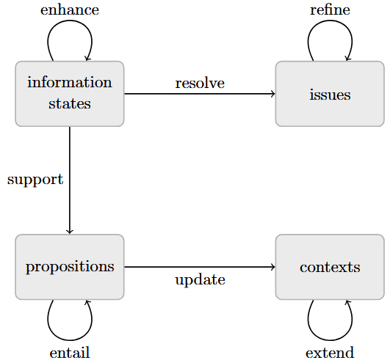
Inquisitive semantics: Basic notions
Ciardelli et al. 2017

Slide 14
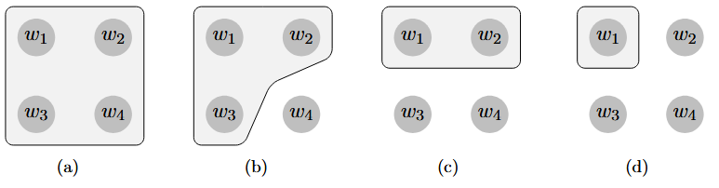
Inquisitive semantics: Information States
Information states are modeled as sets of possible worlds—those worlds that are compatible with the information available in the state.
An information state s is a set of possible worlds, s ⊆ W, where W denotes the set of all possible worlds.
An information state can be thought of as locating the actual world within a certain region of the logical space. The state in (d) contains the information that the actual world is located in the upper left corner of the logical space.
Ciardelli et al. 2017

Slide 15
Inquisitive semantics: Information States
An information state s is a set of possible worlds, s ⊆ W, where W denotes the set of all possible worlds.
A state t is called an enhancement of s just in case t ⊆ s.
Is the state (b) is an enhancement of the state in (a)?
Ciardelli et al. 2017

Slide 16
Inquisitive semantics: Information States
The state (a) is referred to as the ignorant state. Every other state is an enhancement of it.
At the other far end of the enhancement order is the empty state, ∅. This is an enhancement of any other state. It is a state in which all possible worlds have been discarded as candidates for the actual world, i.e., the available information has become inconsistent. It is therefore referred to as the inconsistent state.
Ciardelli et al. 2017

Slide 17
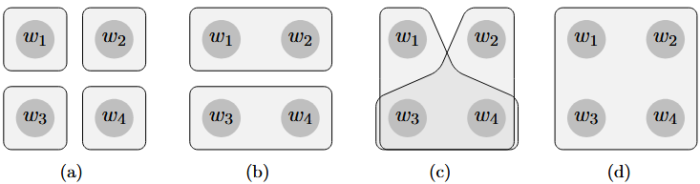
Inquisitive semantics: Issues
An issue is a non-empty, downward closed set of information states.
We say that an information state s resolves an issue I just in case s ∈ I. If s resolves I, we will sometimes also say that I is settled in s.
The issue depicted in subfigure (a) can only be settled consistently by specifying precisely which world is the actual one.
Ciardelli et al. 2017

Slide 18
Inquisitive semantics: Issues
Let I be an issue and s an information state. Then we say that I is an issue over s if and only if ⋃I = s.
Let I, J be two issues over a state s. Then I is at least as inquisitive as J if and only if I ⊆ J. In this case, we say that I is a refinement of J.
Which issue below is the most inquisitive issue over W, and thus a refinement of all other issues? Which issue below is the least inquisitive issue over W, and all other issues are refinements of it?
Ciardelli et al. 2017

Slide 19
Inquisitive semantics: Issues
The maximal elements of an issue I are called the alternatives in I.
Which of the issues below are not inquisitive (contain a single alternative)?
Which of the issues are inquisitive (contain multiple alternatives)?
Ciardelli et al. 2017

Slide 20
Inquisitive semantics: Propositions
A proposition P is a non-empty, downward closed set of information states.
For any proposition P: informative content info(P ) := ⋃P
The issue embodied by a proposition P is the one that is resolved in a state s just in case s ∈ P .
A proposition P is true in a world w just in case w ∈ info(P ).
An information state s supports a proposition P if and only if s ∈ P .
A proposition P is true in a world w if and only if P is supported by {w}.
The informative content of a proposition is the set of all worlds in which the proposition is true.
Ciardelli et al. 2017

Slide 21
Inquisitive semantics: Propositions
We will say that a proposition P is informative just in case its informative content is non-trivial, i.e., info(P ) = W .
We will say that P is inquisitive just in case establishing its informative content is not sufficient to settle the issue that it raises, i.e., info(P) ∈ P .
The maximal elements of a proposition P are called the alternatives in P.
The set of alternatives in P is denoted as alt(P).
A proposition containing finitely many elements is inquisitive if and only if it contains multiple alternatives.
Ciardelli et al. 2017

Slide 22
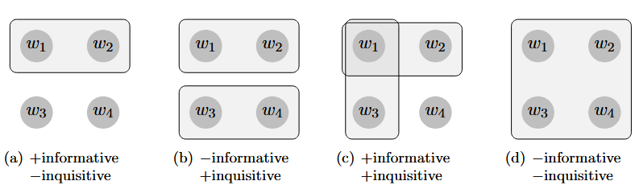
Inquisitive semantics: Propositions
P is non-inquisitive iff info(P ) ∈ P .
P is non-informative iff info(P ) = W .
P is a tautology iff W ∈ P.
Which one of the propositions below is a tautology?
Ciardelli et al. 2017

Slide 23
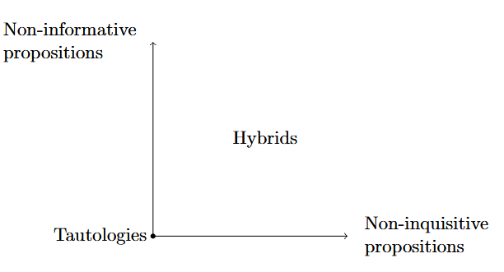
Inquisitive semantics: Propositions
Ciardelli et al. 2017

Slide 24
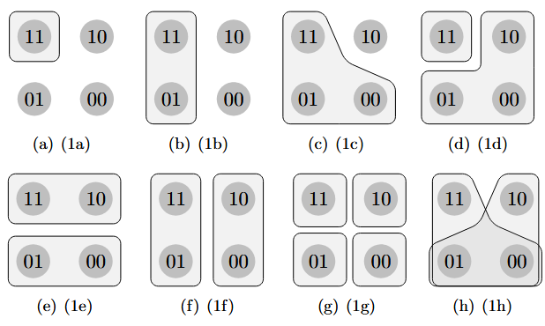
Inquisitive semantics: Propositions
P entails Q just in case P is both at least as informative and at least as inquisitive as Q.
a. The code is 11.
b. The second digit of the code is 1.
c. If the first digit is 1, the second digit is also 1.
d. Is the code 11?
e. What is the first digit?
f. What is the second digit?
g. What is the code?
h. If the first digit is 1, what is the second?
While the semantic contents of (1a)-(1c) could have been captured just as well by means of the standard notion of a proposition as a set of possible worlds, the enriched notion of propositions allows us to analyze also the interrogatives in (1d)-(1h). In each case, the relevant proposition is inquisitive, since it contains multiple alternatives, and it is not informative, since these alternatives jointly cover the entire logical space. This captures the fact that, in uttering one of (1d)-(1h), a speaker raises an issue and does not provide any information.
Ciardelli et al. 2017
Ciardelli et al. 2017

Slide 25
Inquisitive semantics: Propositions
P entails Q just in case P is both at least as informative and at least as inquisitive as Q.
a. The code is 11.
b. The second digit of the code is 1.
c. If the first digit is 1, the second digit is also 1.
d. Is the code 11?
e. What is the first digit?
f. What is the second digit?
g. What is the code?
h. If the first digit is 1, what is the second?
(1a) entails (1b), which in turn entails (1c).
For questions in (1d)-(1h) informative content is trivial, and entailment will compare inquisitive strength; an entailment between a pair of questions will hold if the issue expressed by the first is at least as demanding as the issue expressed by the second.
Does (1g) entail any of the other questions?
Does (1f) entail (1h)?
Questions in (1d) and (1e) are incomparable in terms of inquisitive strength: on the one hand, the information that the code is not 11 resolves (1d) but not (1e); on the other hand, the information that the first digit is 1 resolves (1e) but not (1d); thus, neither of these questions entails the other.
A declarative entails an interrogative just in case the information provided by the former suffices to resolve the issue raised by the latter.
(1a) entails all of the above questions; (1b) entails only (1f) and (1h); and (1c) entails only (1h).
Conversely none of the above questions entails any of the given declaratives. This is because, in terms of informative content, (1d)-(1h) are trivial, while (1a)-(1c) are not. Ciardelli et al. 2017

Slide 26
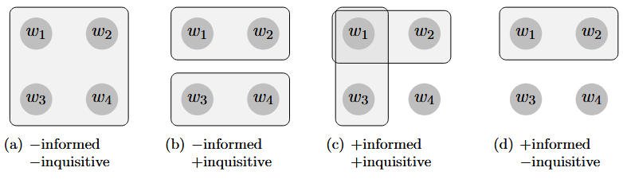
Inquisitive semantics: Contexts
A context C is a non-empty, downward closed set of information states.
For any context C: info(C) := ⋃C
A context C is informed iff info(C) = W.
A context C is uninformed iff info(C) = W.
A context C is inquisitive iff info(C) ∈ C.
A context C is indifferent iff info(C) ∈ C.
Ciardelli et al. 2017

Slide 27
Inquisitive semantics: Contexts
C′ is an extension of C, C′ ≥ C, iff C′ ⊆ C.
The contexts in (b), (c), and (d) are all extensions of the trivial context in (a).
(d) is also an extension of (b) and (c), but neither (b) nor (c) is an extension of the other.
Ciardelli et al. 2017

Slide 28
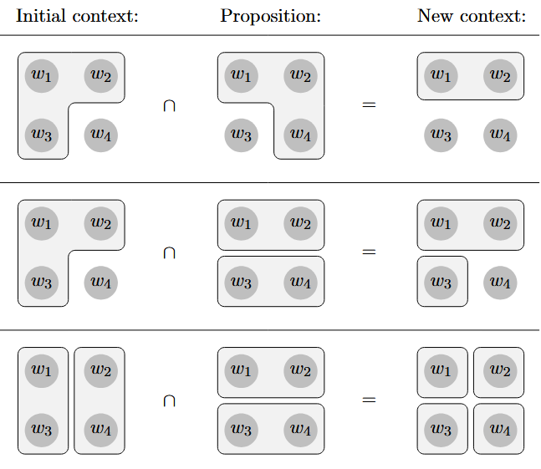
Inquisitive semantics: Contexts
Context update C[P ] := C ∩ P
Ciardelli et al. 2017

Slide 29
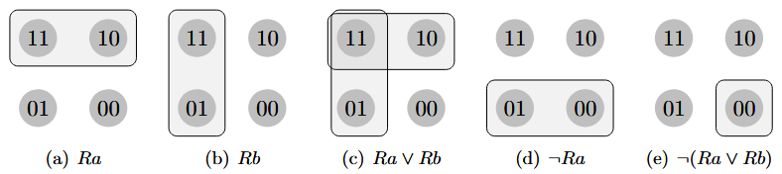
Inquisitive semantics: Basic operations and projection operators
Let’s assume that our language contains just one unary predicate symbol, R, and two individual constants, a and b.
The domain of discourse consists of just two objects, denoted by a and b.
Our logical space consists of four worlds, one in which both Ra and Rb are true, one in which Ra is true but Rb is false, one in which Rb is true but Ra is false, and one in which neither Ra nor Rb is true. These worlds will be labeled 11, 10, 01, and 00, respectively.
For concreteness, we will read Ra as ‘Ann is in Rome’, and Rb as ‘Bob is in Rome’.
Ciardelli et al. 2017

Slide 30
Inquisitive semantics: Basic operations and projection operators
Let us first consider the proposition expressed by the atomic sentences Ra and Rb.
[Ra] consists of all states s such that every world in s makes Ra true, i.e., the state {11, 10} and all substates thereof.
Ra is non-inquisitive. It provides the information that Ann is in Rome, and it does not request any further information.
Analogously, Rb provides the information that Bob is in Rome, without requesting any further information.
Ciardelli et al. 2017

Slide 31
Inquisitive semantics: Basic operations and projection operators
Disjunction [Ra ∨ Rb] consists of those states that are in [Ra] or in [Rb]. These are {11, 10}, {11, 01}, and all substates thereof.
Since info(Ra ∨ Rb) = ⋃[Ra ∨ Rb] = {11, 10, 01} = W , the disjunction Ra ∨ Rb is informative. It provides the information that at least one of Ann and Bob is in Rome.
Since there are two maximal elements, it is also inquisitive. In order to settle the issue that it raises, one has to establish either that Ann is in Rome, or that Bob is in Rome.
Ciardelli et al. 2017

Slide 32
Inquisitive semantics: Basic operations and projection operators
A disjunctive sentence Ra ∨ Rb does not necessarily correspond to a disjunctive declarative sentence in English like (1) below, or to a disjunctive interrogative sentence like (2).
(1) Ann is in Rome or Bob is in Rome. !(Ra ∨ Rb)
(2) Is Ann in Rome, or is Bob in Rome? ?(Ra ∨ Rb) or Ra ∨ Rb, depending on intonation
Ciardelli et al. 2017

Slide 33
Inquisitive semantics: Basic operations and projection operators
[¬Ra] consists of all states s such that s does not have any world in common with any state in [Ra]. Thus, [¬Ra] consists of all states that do not contain the worlds 11 and 10, which are |¬Ra| = {01, 00} and all substates thereof.
¬Ra is non-inquisitive. It provides the information that Ann is not in Rome, and does not request any further information.
Ciardelli et al. 2017

Slide 34
Inquisitive semantics: Basic operations and projection operators
[¬(Ra ∨ Rb)] consists of all states which do not have a world in common with any state in [Ra ∨ Rb]. Thus, [¬(Ra ∨ Rb)] consists of all states that do not contain the worlds 11, 10, and 01, which are {00}and ∅.
¬(Ra ∨ Rb) provides the information that neither Ann nor Bob is in Rome and does not request any further information.
The absolute pseudo-complement of a proposition always contains a greatest element.
This means that a negative sentence ¬ϕ is never inquisitive; it simply provides the information that ϕ is false, and does not request any further information.
Ciardelli et al. 2017

Slide 35
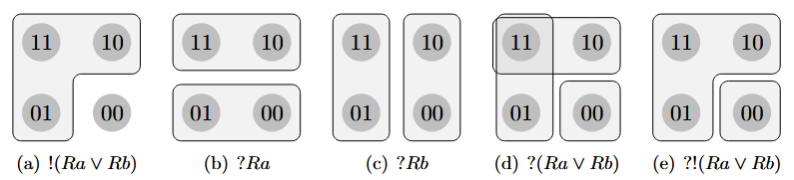
Inquisitive semantics: Basic operations and projection operators
Let us consider !(Ra ∨ Rb), which abbreviates ¬¬(Ra ∨ Rb).
For any sentence ϕ, !ϕ is a non-inquisitive proposition with the same informative content as ϕ.
Ciardelli et al. 2017

Slide 36
Inquisitive semantics: Basic operations and projection operators
Consider ?Ra, which is an abbreviation of Ra ∨ ¬Ra.
[?Ra] = [Ra ∨ ¬Ra] consists of all states that are either in [Ra] or in [¬Ra]. These states are |Ra|, |¬Ra|, and all substates thereof.
Since info(?Ra) = W , ?Ra is non-informative.
Since [?Ra] contains two alternatives, it is inquisitive. In order to settle the issue that it raises, one has to establish either that Ann is in Rome, or that Ann is not in Rome. That is, one has to establish whether Ann is in Rome.
Ciardelli et al. 2017

Slide 37
Inquisitive semantics: Basic operations and projection operators
If ? applies to the disjunction Ra ∨ Rb, which is already inquisitive, then it yields the proposition depicted in (d).
[Ra ∨ Rb] already contains two alternatives, |Ra| and |Rb|; ? adds a third alternative, which is the set of worlds that are neither in |Ra| nor in |Rb|.
Thus, in order to resolve the issue raised by ?(Ra ∨ Rb), one has to establish either that Ann is in Rome, or that Bob is, or that neither is.
Ciardelli et al. 2017

Slide 38
Inquisitive semantics: Basic operations and projection operators
Let us consider a case where ! and ? both apply, one after the other: ?!(Ra ∨ Rb).
[!(Ra ∨ Rb)] contains a single alternative, consisting of all worlds where at least one of a and b is in Rome.
? adds a second alternative, which is the set of worlds where neither Ann nor Bob is in Rome.
Notice that the resulting proposition differs from that expressed by ?(Ra ∨ Rb), which contains three alternatives rather than two. In order to settle the issue expressed by ?!(Ra ∨ Rb) it is sufficient to establish that at least one of Ann and Bob is in Rome.
In order to settle the issue expressed by ?(Ra ∨ Rb) this is not sufficient; rather, it needs to be established of one of Ann and Bob that he or she is in Rome, or that neither of them is.
Ciardelli et al. 2017

Slide 39
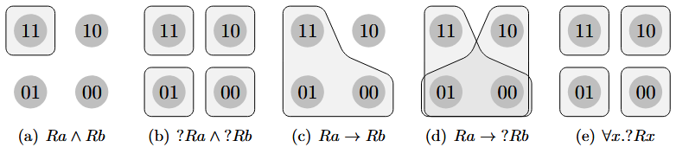
Inquisitive semantics: Basic operations and projection operators
[Ra ∧ Rb] consists of those states that are both in [Ra] and in [Rb]. These are {11} and ∅. Thus, [Ra ∧ Rb] has a greatest element, namely {11}, and accordingly Ra ∧ Rb provides the information that both Ann and Bob are in Rome and does not request any further information.
Ciardelli et al. 2017

Slide 40
Inquisitive semantics: Basic operations and projection operators
The proposition [?Ra ∧ ?Rb] contains four alternatives, |Ra ∧ Rb|, |Ra ∧ ¬Rb|, |¬Ra ∧ Rb|, and |¬Ra ∧ ¬Rb|.
Since these alternatives together cover the entire logical space ?Ra ∧ ?Rb is non-informative.
Since there is more than one alternative, ?Ra ∧ ?Rb is inquisitive.
Thus, the conjunction is a purely inquisitive sentence which requests enough information to settle both the issue whether Ann is in Rome, contributed by ?Ra, and the issue whether Bob is in Rome, contributed by ?Rb.
If ϕ and ψ are non-inquisitive, then the conjunction ϕ ∧ ψ is non-inquisitive as well, conveying both the information provided by ϕ and the information provided by ψ; on the other hand, if ϕ and ψ are non-informative, then the conjunction ϕ∧ψ is non-informative as well, expressing an issue which is settled just in case both the issue expressed by ϕ and the one expressed by ψ are settled.
Ciardelli et al. 2017

Slide 41
Inquisitive semantics: Basic operations and projection operators
Implication [Ra → Rb] consists of all states s such that every substate t ⊆ s that is in [Ra] is also in [Rb]. These are all and only those states that are contained in |Ra → Rb| = {11, 01, 00}.
[Ra → Rb] has a unique greatest element, which means that the implication Ra → Rb is a non-inquisitive sentence which provides the information that if Ann is in Rome, then so is Bob.
Ciardelli et al. 2017

Slide 42
Inquisitive semantics: Basic operations and projection operators
The proposition [Ra → ?Rb] contains two alternatives, |Ra → Rb| = {11, 01, 00}, and |Ra → ¬Rb| = {10, 01, 00}. Since these two alternatives together cover the entire logical space, our implication is non-informative. Since there is more than one alternative, the implication is inquisitive. In order to settle the issue that it raises, one must either establish Ra → Rb, or Ra → ¬Rb. In the former case one establishes that if Ann is in Rome, then so is Bob; in the latter case, that if Ann is in Rome, then Bob isn’t. So Ra → ?Rb requests enough information to establish whether Bob is in Rome under the assumption that Ann is.
If ψ is non-inquisitive, then ϕ → ψ is non-inquisitive as well; similarly, if ψ non-informative, then ϕ → ψ is non-informative as well.
Ciardelli et al. 2017

Slide 43
Inquisitive semantics: Basic operations and projection operators
Existential quantification behaves essentially like disjunction and universal quantification behaves essentially like conjunction.
Since our current domain of discourse consists of only two objects, denoted by a and b, ∃x.Rx expresses exactly the same proposition as Ra ∨ Rb, and ∀x.Rx expresses exactly the same proposition as Ra ∧ Rb.
Consider the proposition expressed by ∀x.?Rx.
Notice that this proposition induces a partition on the logical space, where each block of the partition consists of worlds that agree on the extension of R. Thus, ∀x.?Rx asks for an exhaustive specification of the individuals that are in Rome.
Ciardelli et al. 2017

Slide 44
Inquisitive semantics: Sufficient conditions for non-inquisitivity
Atomic sentences are always non-inquisitive;
¬ϕ is always non-inquisitive;
!ϕ is always non-inquisitive;
If ϕ and ψ are non-inquisitive, then so is ϕ ∧ ψ;
If ψ is a non-inquisitive, then so is ϕ → ψ for any antecedent ϕ;
If ϕ(d′) is a non-inquisitive for all d ∈ D, then so is ∀xϕ(x).
Any sentence that does not contain ∨, ∃, or ? is non-inquisitive.
In many natural languages, question words are homophonous with words for disjunction and/or existentials.
Ciardelli et al. 2017

Slide 45
Inquisitive semantics: Sufficient conditions for non-informativity
?ϕ is always non-informative;
If ϕ and ψ are non-informative, so is ϕ ∧ ψ;
If ψ is non-informative, then so are ϕ ∨ ψ and ϕ → ψ, for any ϕ;
If ϕ(d′) is non-informative for all d ∈ D, then so is ∀xϕ(x);
If ϕ(d′) is non-informative for some d ∈ D, then so is ∃xϕ(x).
Ciardelli et al. 2017

Slide 46
Inquisitive semantics: Polar Questions
Polar questions are questions that ask for the truth-value of a given proposition
(1) Is Alice married to Bob? ?Mab
(2) [(1)] = [?Mab] = {|Mab|, |Mab|}↓
The issue expressed by (1) is resolved in an information state s if it follows from the information available in s that Alice is married to Bob (i.e., if s ⊆ |Mab|) or if it follows that Alice is not married to Bob (i.e., if s ⊆ |Mab|).
For any set of information states P, we will write P↓ for the set of information states that are contained in some element of P.
Ciardelli et al. 2017

Slide 47
Inquisitive semantics: Alternative Questions
Alternative questions are questions that list a number of options, separated by disjunction, and ask for a choice among these
(1) Is Alice married to Bob↑ or to Charlie↓? Mab ∨ Mac
(2) [(1)] = [Mab ∨ Mac] = {|Mab|, |Mac|}↓
The issue expressed by (1) is resolved in an information state s if it follows from the information available in s that Alice is married to Bob (i.e., if s ⊆ |Mab|) or if it follows that she is married to Charlie (i.e., s ⊆ |Mac|).
One concern with translating (1) in this way is that, in our terminology, the formula Mab ∨ Mac is not only inquisitive, but also informative. Its informative content is that Alice is married to either Bob or Charlie. However, in uttering the question in (1), a speaker does not present the information that Alice is married to either Bob or Charlie as new information, but rather as something that she presupposes.
Ciardelli et al. 2017

Slide 48
Inquisitive semantics: Alternative Questions
Alternative questions are questions that list a number of options, separated by disjunction, and ask for a choice among these
(1) Is Alice married to Bob↑ or not↓? Mab ∨ ¬Mab
In this case, the translation is Mab ∨ ¬Mab is equivalent with the translation that we provided for the polar question: ?Mab.
This is expected, since the two questions indeed express the same issue.
Ciardelli et al. 2017

Slide 49
Inquisitive semantics: Alternative Questions
Alternative questions are questions that list a number of options, separated by disjunction, and ask for a choice among these
(1) Is Alice married to Bob or to Charlie↑? ?!(Mab ∨ Mac)
(2) [(1)] = [?!(Mab ∨ Mac)] = {|Mab ∨ Mac|, |Mab ∨ Mac|}↓
There is no intonational phrase boundary after the first disjunct, i.e., the two disjuncts are pronounced in a single intonational phrase, and the final pitch contour is rising rather than falling.
With this intonation pattern, the question is interpreted as a polar question, asking whether it is true or false that Alice is married to Bob or Charlie.
The issue expressed by (1) is resolved in an information state s if it follows from the information available in s that Alice is married to Bob or Charlie (i.e., if s ⊆ |Mab ∨ Mac|) or if it follows that she is not married to either Bob or Charlie (i.e., s ⊆ |Mab ∨ Mac|).
Ciardelli et al. 2017

Slide 50
Inquisitive semantics: Open disjunctive questions
Context: Susan, who is in her sixties, decided to organise a high school reunion. She is now sending out invitation letters. In school, Susan was close friends with Alice, Bob, Charlie, and Drew. After school, she moved to Spain and only kept in touch with Drew. She heard long ago that Alice ended up marrying someone from their class, but she doesn’t know who exactly. In case Alice got married to Bob or Charlie, Susan wants to write an invitation letter to Alice and Bob/Charlie together, and say something nice about their marriage. In case Alice got married to someone else, she will just send her an individual invitation letter and won’t mention her marriage. So she calls Drew and asks her:
Is Alice married to Bob↑ or to Charlie↑? ?(Mab ∨ Mac)
(2) [(1)] = [?(Mab ∨ Mac)] = {|Mab|, |Mac|, |Mab ∨ Mac|}↓
Note in particular that an information state in which it is established that Alice is married to either Bob or Charlie, but not to which of the two, does not contain enough information to settle the issue expressed by (1), while it does settle the issue expressed by the polar question. Also note that (1) does not presuppose that Alice is married to either Bob or Charlie, unlike the alternative question.
Ciardelli et al. 2017

Slide 51
Inquisitive semantics: Wh-questions
(1) a. Who did Alice invite to her birthday party? mention-all questions
b. What is something that Alice really likes? mention-some questions
c. Who is Alice married to? single-match questions
d. Who is married to whom? questions with multiple wh-words
e. Which students did Alice invite to her party? questions with explicit domain restriction
Ciardelli et al. 2017

Slide 52
Inquisitive semantics: Wh-questions
Mention-all wh-questions ask for a complete specification of the individuals that have a certain property—i.e., for a specification of the complete extension of the property in the relevant domain of discourse. Under its most salient interpretation.
(1) Who did Alice invite to her birthday party? ∀x?Pax
The issue expressed by (1) is resolved in a state s if the information available in s determines exactly which individuals in the domain were invited to Alice’s party.
It is easy to check that this is equivalent to the requirement that for each individual d ∈ D, s should determine whether or not d was invited (s ⊆ |Pad| or s ⊆ |Pad|).
(2) [(1)] = [∀x?Pax] = {s | ∀d ∈ D : s ⊆ |Pad| or s ⊆ |Pad|}
Ciardelli et al. 2017

Slide 53
Inquisitive semantics: Wh-questions
Mention-some wh-questions just ask for an instance of a certain property.
(1) What is something that Alice really likes?
The issue expressed by (1) is resolved in an information state s if the information available in s implies, for some object d, that Alice really likes d.
(2) [(1)] = [∃xLax] = {|Lad| | d ∈ D}↓
It should be noted that the concern we mentioned above for alternative questions also arises here: the sentence ∃xLax has non-trivial informative content, namely that there is at least one thing that Alice really likes. However, in asking the question in (1) the speaker does not present this information as new information, but rather presupposes it.
Ciardelli et al. 2017

Slide 54
Inquisitive semantics: Wh-questions
Mention-some wh-questions just ask for an instance of a certain property.
(1) What is something that Alice really likes?
The issue expressed by (1) is resolved in an information state s if the information available in s implies, for some object d, that Alice really likes d.
(2) [(1)] = [∃xLax] = {|Lad| | d ∈ D}↓
It should be noted that the concern we mentioned above for alternative questions also arises here: the sentence ∃xLax has non-trivial informative content, namely that there is at least one thing that Alice really likes. However, in asking the question in (1) the speaker does not present this information as new information, but rather presupposes it.
A relatively understudied, but common type:
a. Where can I buy an Italian newspaper around here? e. What would you like to get for your birthday?
b. What is a typical French dish? f. Who is driving to the party and has space for an extra passenger?
c. What is a number we can call in case of an emergency? g. What would hold these two sticks firmly together?
d. What is an example of a unprovable arithmetic theorem? h. How do I get to the station from here?
Ciardelli et al. 2017

Slide 55
Inquisitive semantics: Wh-questions
Single-match wh-questions ask for the unique individual having a certain property.
(1) Who is Alice married to? ∃xMax
The issue expressed by (1) is resolved in an information state s if, for a specific individual d in the relevant domain of discourse, the information available in s implies that Alice is married to d.
(2) [(1)] = [∃xMax] = {|Mad| | d ∈ D}↓
As is clear from this analysis, single-match wh-questions are a special case of mention-some wh-questions in which the relevant property can be satisfied by at most one individual.
However the alternatives for single-match wh-questions always form a partition of a subset of the logical space. In this respect, they are more similar to mention-all questions than to other mention-some questions.
Ciardelli et al. 2017

Slide 56
Inquisitive semantics: Wh-questions
Multiple wh-questions are mention-all wh-questions: they ask for a specification of all the individuals that stand in a certain relation—here, the relation of being married:
(1) Who is married to whom? ∀x∀y?Mxy
(2) [(1)] = [∀x∀y?Mxy] = {s | ∀d,d′ ∈ D : s ⊆ |Mdd′| or s ⊆ |Mdd′|}
Ciardelli et al. 2017

Slide 57
Inquisitive semantics: Wh-questions
Sometimes, the wh-phrase in a wh-question involves an explicit domain restrictor:
(1) Which students did Alice invite to her party?
Under the de dicto reading, (1) asks for a specification of the set of students who were invited by Alice. The issue expressed by (1) under this reading is resolved in an information state s in case for every individual d, s determines whether or not d is a student who was invited by Alice.
(2) [(1)] = [∀x?(Sx ∧ Pax)] = {s | ∀d ∈ D : s ⊆ |Sd| ∩ |Pad| or s ⊆ |Sd| ∩ |Pad|}
Under the de re reading, the addressee is asked to specify for each actual student d whether d was invited by Alice.
(3) [(1)] = [?Pad₁ ∧ · · · ∧ ?Pad_{n}] = {s | ∀d ∈ Iw₀(S): s ⊆ |Pad| or s ⊆ |Pad|}
Ciardelli et al. 2017

Slide 58
Inquisitive semantics: Wh-questions
Sometimes, the wh-phrase in a wh-question involves an explicit domain restrictor:
(1) Which students did Alice invite to her party?
Alternatively, (1) expresses an issue which is resolved if for every individual d, under the assumption that d is a student, it is known whether d was invited by Alice:
(2) [(1)] = [∀x(Sx → ?Pax)] = {s | ∀d ∈ D: s ∩ |Sd| ⊆ |Pad| or s ∩ |Sd| ⊆ |Pad|}
Ciardelli et al. 2017

Slide 59
Inquisitive semantics: Conjoined questions
The issue expressed by (1) is resolved in an information state s just in case s resolves both the issue whether Alice likes Bob, and the issue whether Bob likes Alice.
(1) Does Alice like Bob, and does he like her? ?Lab ∧ ?Lba
(2) [(1)] = [?Lab ∧ ?Lba] = [?Lab] ∩ [?Lba] = {|Lab| ∩ |Lba|, |Lab| ∩ |Lba|, |Lab| ∩ |Lba|, |Lab| ∩ |Lba|}↓
Ciardelli et al. 2017

Slide 60
Inquisitive semantics: Disjoined questions
A question like (1), consisting of two mention-some wh-questions which are coordinated by means of the disjunction word or, asks for information which resolves either one of the disjuncts.
More precisely, the issue expressed by (1) is resolved in an information state s if s implies for some individual d that d can drive Alice to the party, or if s implies for some individual d that d can lend Alice a car.
(1) Who can drive Alice to the party, or who can lend her a car? ∃xDxa ∨ ∃xLxa
(2) [(1)] = [∃xDxa ∨ ∃xLxa] = [∃xDxa] ∪ [∃xLxa] = {|Dda| | d ∈ D}↓ ∪ {|Lda| | d ∈ D}↓
Ciardelli et al. 2017

Slide 61
Inquisitive semantics: Conditional questions
Conditional questions ask for a resolution of a question, specified by the main clause, under a certain assumption which is specified by an adjoined if-clause.
The issue expressed by (1) is resolved in an information state s if restricting s to those worlds where Alice wins two tickets results in a state s ∩ |Wa| which resolves the issue of who Alice will take with her, i.e., a state which implies for some individual d that Alice will take d with her.
(1) If Alice wins two tickets, who will she take with her? Wa → ∃xTax
(2) [(1)] = [Wa → ∃xTax] = {s | s ∩ |Wa| ∈ [∃xTax]} = {s | for some d ∈ D : s ∩ |Wa| ⊆ |Tad|}
Ciardelli et al. 2017

Slide 62
Inquisitive semantics: Questions
Context: Mary keeps a small collection of things that could be nice gifts. At the moment she has two items in her collection: a small Picasso reproduction and a beautiful handicraft book rest that she got on a trip to India. A good friend of hers, Sue, is getting married. She knows that Sue loves ceramics, so that’s what she’ll give her. But she also wants to give her fiancee Ben something. She doesn’t know him so well yet, though, so she asks Sue:
Mary: Does Ben like Picasso↑ or does he read a lot↑?
Consider the following possible translations in Inquisitive Semantics:
a. Pb ∨ Rb
b. ?(Pb ∨ Rb)
c. ?!(Pb ∨ Rb)
d. ?Pb ∨ ?Rb
Which translation is the most appropriate? Why?
Ciardelli et al. 2017

Slide 63
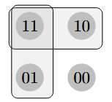
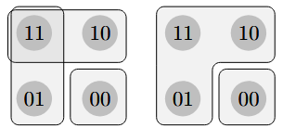
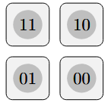
Inquisitive semantics: Questions
Mary: Does Ben like Picasso↑ or does he read a lot↑?
a. Pb ∨ Rb
b. ?(Pb ∨ Rb)
c. ?!(Pb ∨ Rb)
d. ?Pb ∨ ?Rb
Which translation is the most appropriate? Why?
Ciardelli et al. 2017

Slide 64
Inquisitive semantics: Disjunction, clause typing, and intonation
Let’s have a closer look at how disjunction interacts with clause typing (declarative versus interrogative) and intonation (intonational phrase structure and final pitch contours), showing that inquisitive semantics allows us to treat disjunction uniformly across statements and questions with various intonation patterns.
(1) Does Igor speak Spanish-or-French↑?
(2) Does Igor speak Spanish↑ or does he speak French↓?
(3) Does Igor speak Spanish↑ or does he speak French↑?
(4) Igor speaks Spanish-or-French↓.
(5) Igor speaks Spanish↑ or he speaks French↓.
Does the difference in syntactic structure between (4) and (5) result in a difference in interpretation?
Ciardelli et al. 2017

Slide 65
Inquisitive semantics: Disjunction, clause typing, and intonation
Rule for translating the body of a list:
[[C_{DECL/INT} TP₁] or . . . or [C_{DECL/INT} TP_{n}]] !ϕ₁ ∨ . . . ∨ !ϕ_{n}
[C_{INT} does Igor speak Spanish or French] !(p ∨ q)
[C_{INT} does Igor speak Spanish] or [C_{INT} does he speak French] !p ∨ !q
Rules for translating lists:
a. [[CLOSED DECL] body] !ϕ
b. [[CLOSED INT] body] 〈?〉ϕ
c. [[OPEN DECL] body] ?ϕ
d. [[OPEN INT] body] ?ϕ
Ciardelli et al. 2017

Slide 66
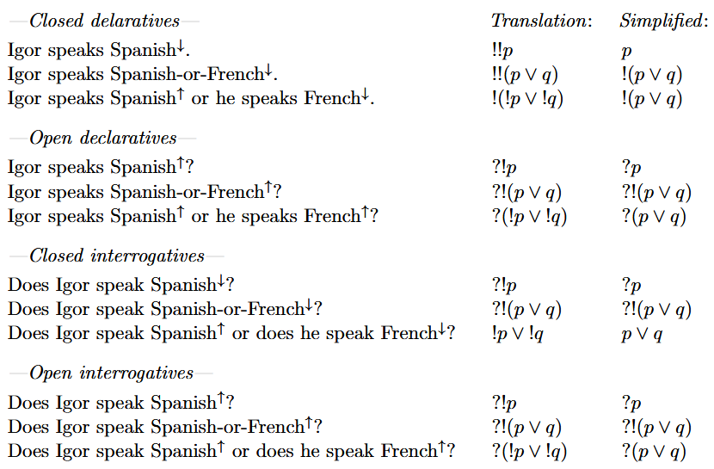
Inquisitive semantics: Disjunction, clause typing, and intonation
Ciardelli et al. 2017

Slide 67
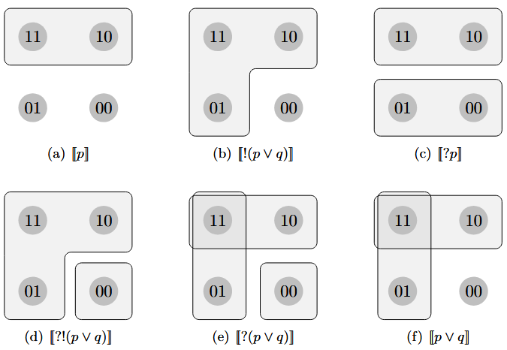
Inquisitive semantics: Disjunction, clause typing, and intonation
Ciardelli et al. 2017

Slide 68
Inquisitive semantics: Disjunction, clause typing, and intonation
(1) Does Igor speak Spanish-or-French↑? ?!(p ∨ q)
(2) Does Igor speak Spanish↑ or does he speak French↓? p ∨ q
(3) Igor speaks Spanish-or-French↓. !(p ∨ q)
(4) Igor speaks Spanish↑ or he speaks French↓. !(p ∨ q)
What can you say about the acceptability and interpretation of yes and no in response to sentences (1)-(4)?
Ciardelli et al. 2017

Slide 69
Inquisitive semantics: Disjunction, clause typing, and intonation
A sentence, besides expressing a certain proposition that captures its informative and inquisitive content, generally also highlights a set of propositions, which may serve as the antecedents for subsequent anaphoric expressions.
– yes and no are such anaphoric expressions:
∗ Both yes and no presuppose that the previous sentence highlighted a unique proposition.
∗ If this presupposition is met, yes confirms the unique highlighted proposition, while no rejects it.
∗ If the presupposition is not met, the meaning of yes and no is not defined.
– A yes/no response is only fully satisfactory if its presupposition is met and it resolves the issue raised by the previous sentence.
Ciardelli et al. 2017

Slide 70
Inquisitive semantics: Propositional attitudes
Besides the familiar information-directed attitudes like knowing and believing IS also allows us to model issue-directed attitudes like wondering and being curious.
(1) a. Alice knows that Bob is coming.
b. Alice knows whether Bob is coming.
c. Alice knows whether Bob or Charlie is coming.
d. Alice knows who is coming.
(2) a. Alice wonders whether Bob is coming.
b. *Alice wonders that Bob is coming.
Ciardelli et al. 2017

Slide 71
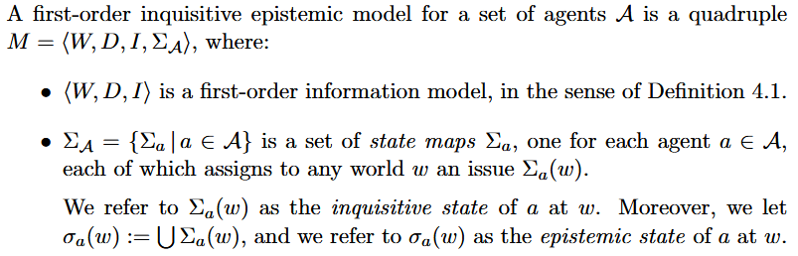


Inquisitive semantics: Inquisitive epistemic models
The truth-conditions of Kaϕ are very simple: Kaϕ is true at w just in case ϕ is supported by the epistemic state of a at w.
Ciardelli et al. 2017

Slide 72
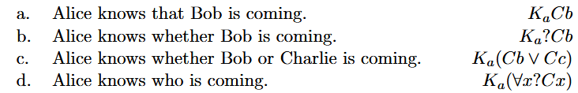
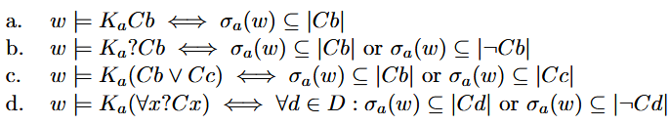
Inquisitive semantics: Knowledge
The truth-conditions for these modal formulas are as follows:
A sentence Alice knows that S is predicted to be true true in case it follows from Alice’s knowledge that S is true. (b) is true in case Alice’s knowledge implies that Bob is coming, or it implies that Bob is not coming; (c) is true in case Alice’s knowledge implies that Bob is coming, or it implies that Charlie is coming; finally, (d) is true in case for each individual d in the domain, Alice’s knowledge implies either that d is coming, or that d is not coming; in other words, (d) is true if Alice’s knowledge determines exactly what is the set of individuals who are coming.
Ciardelli et al. 2017

Slide 73



Inquisitive semantics: Wondering
For each agent a we also have the modality Ea which allows us to talk about the issues that the agent entertains.
Given these truth conditions, it is clear that Eaϕ is supported by a state s just in case it is true at any world in s.
Ciardelli et al. 2017

Slide 74
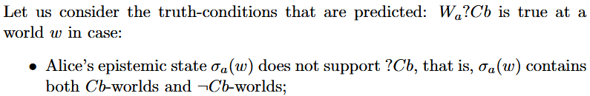
Inquisitive semantics: Wondering
For each agent a we also have the modality Ea which allows us to talk about the issues that the agent entertains.
Given these truth conditions, it is clear that Eaϕ is supported by a state s just in case it is true at any world in s.
Alice wonders whether Bob is coming. Wa?Cb
Ciardelli et al. 2017

Slide 75
Inquisitive semantics: Wondering
Alice wonders whether Bob is coming. Wa?Cb
Condition (i) means that Alice’s current knowledge does not determine whether Bob is coming; condition (ii) means that resolving Alice’s issues is bound to lead to a state that determines whether Bob is coming; in other words, Alice’s issues are not resolved unless it is established whether Bob is coming or not.
Ciardelli et al. 2017

Slide 76


Inquisitive semantics: Wondering
*Alice wonders that Bob is coming.
Combining wonder with a declarative complement systematically results in a contradiction.
Ciardelli et al. 2017

Slide 77
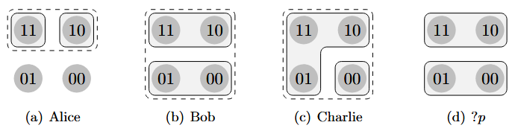
Inquisitive semantics: Wondering
The solid blocks represent the maximal elements of the agent’s inquisitive state, while the dashed area—corresponding to the union of these blocks—represents the agent’s knowledge.
Who wonders whether p? Alice, Bob, or Charlie?
Ciardelli et al. 2017

Slide 78
Inquisitive semantics: Wondering
The solid blocks represent the maximal elements of the agent’s inquisitive state, while the dashed area—corresponding to the union of these blocks—represents the agent’s knowledge.
Alice’s epistemic state implies that p is true and thereby supports the question: thus, Ka?p is true, i.e., Alice knows whether p. From this it follows that Wa?p is false (because the condition ¬Ka?p fails), i.e., Alice does not wonder whether p.
Ciardelli et al. 2017

Slide 79
Inquisitive semantics: Wondering
The solid blocks represent the maximal elements of the agent’s inquisitive state, while the dashed area—corresponding to the union of these blocks—represents the agent’s knowledge.
Bob’s epistemic state is trivial, and it does not support the question ?p. Thus, Kb?p is false, i.e., Bob does not know whether p. On the other hand, the information states where Bob’s issues are resolved—the elements of Σb(w)—are precisely the information states in which ?p is supported. This means that Eb?p is true. Together with ¬Kb?p, this implies that Wb?p is true, i.e., Bob wonders whether p.
Ciardelli et al. 2017

Slide 80
Inquisitive semantics: Wondering
The solid blocks represent the maximal elements of the agent’s inquisitive state, while the dashed area—corresponding to the union of these blocks—represents the agent’s knowledge.
Charlie’s epistemic state is trivial as well, which means that, like Bob, Charlie doesn’t know whether p. However, some elements of his inquisitive state (e.g., the information state {11, 10, 01}) fail to support the question ?p. This means that Ec?p is false, and therefore, Wc?p is false as well: thus, unlike Bob, Charlie does not wonder whether p.
Ciardelli et al. 2017

Slide 81
Inquisitive semantics: Wondering
The solid blocks represent the maximal elements of the agent’s inquisitive state, while the dashed area—corresponding to the union of these blocks—represents the agent’s knowledge.
Interestingly, both Alice and Charlie do not wonder whether p, but for different reasons: in Alice’s case, it’s because she has already resolved the question, while in Charlie’s case, it’s because he is not interested in resolving it.
Ciardelli et al. 2017

